Slide 1
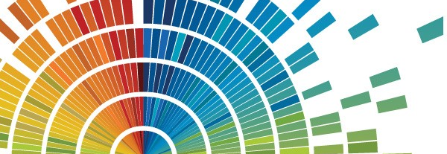
Data visualization: Basic principles
Maria Rivera Araya
mariajose.riveraaraya@jcu.edu.au

Slide 2
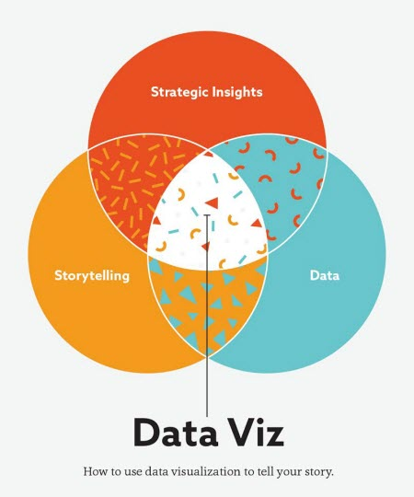
Agenda
- Basic steps – How to start?
- Who, why, what
- Colours
- Practices to avoid
- Resources
Munzner, T. (2015). Visualization Analysis and Design. Boca Raton, FL: A K Peters/CRC Press.
Textbook (Knaflic, 2015) – Introduction (pp. 1–17). Reference: Knaflic, C. N. (2015). Storytelling with data: A data visualization guide for business professionals. Hoboken, NJ: Wiley.

Slide 3

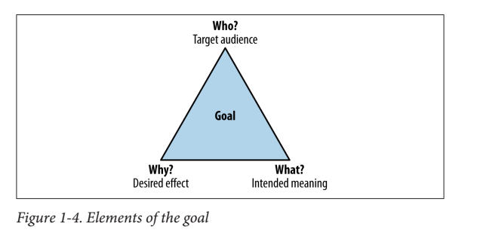
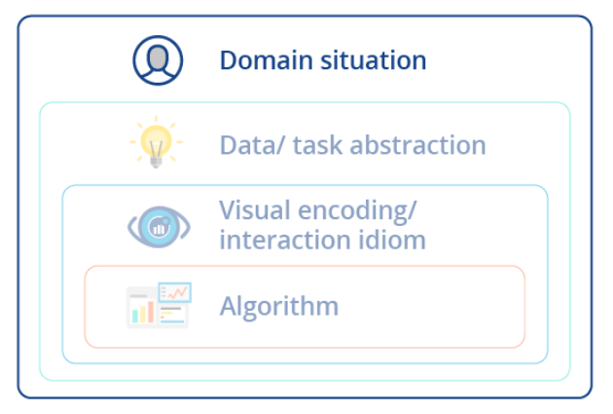
How to start?
Step 1 Who?
Identify target audience
Identify users’ questions
Identify users’ requirements:
Previous knowledge
Vocabulary
Expectations
Assumptions

Slide 4
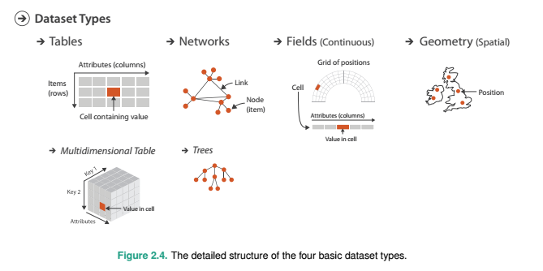
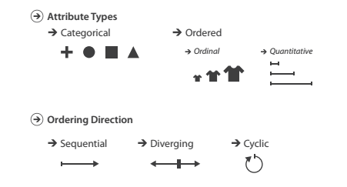
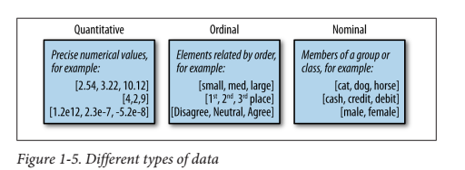
Steps #2-3
Your WHY - WHAT

Slide 5
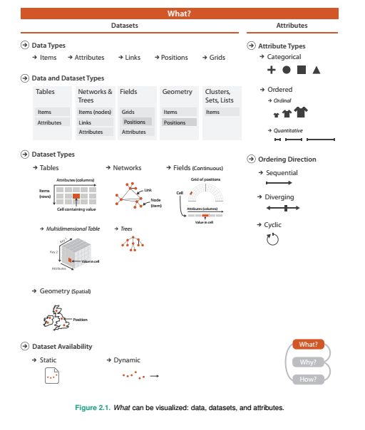

Slide 6
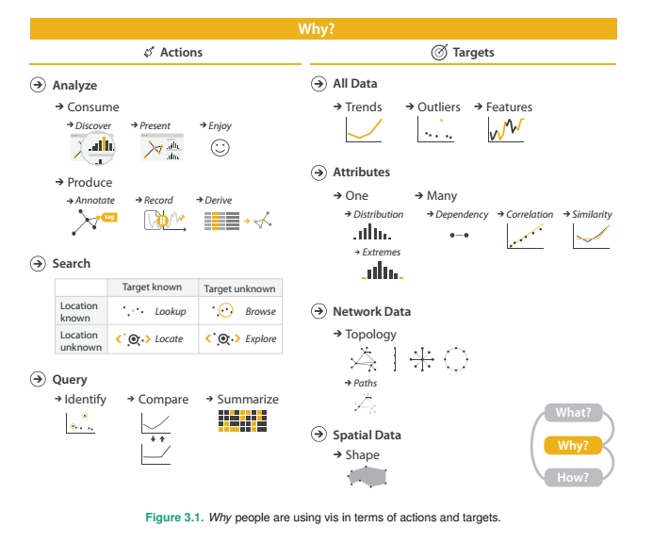

Slide 7
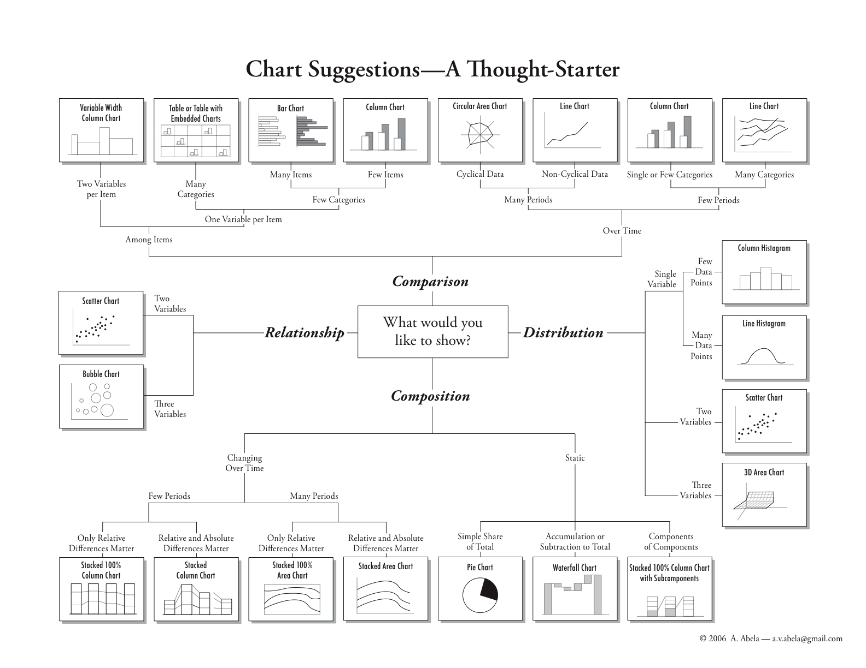
Step 4 HOW?
http://www.infographicsblog.com/chart-suggestions-a-thought-starter-andrew-abela/

Slide 8
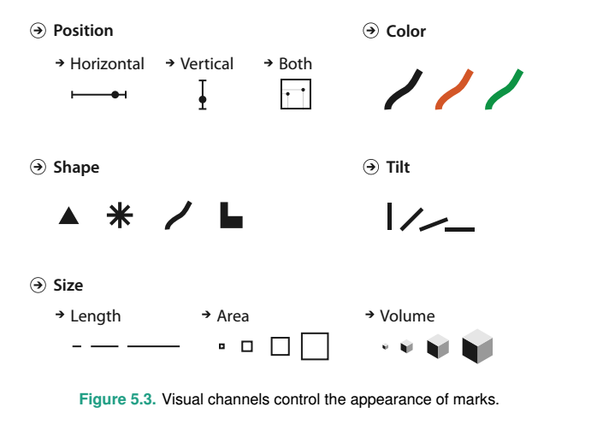
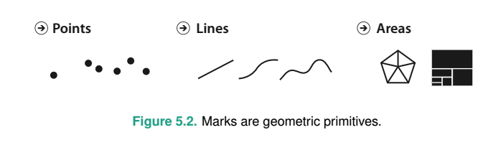
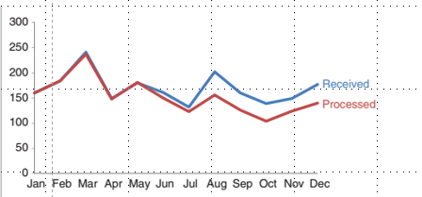
How do we build a graph?

Slide 9
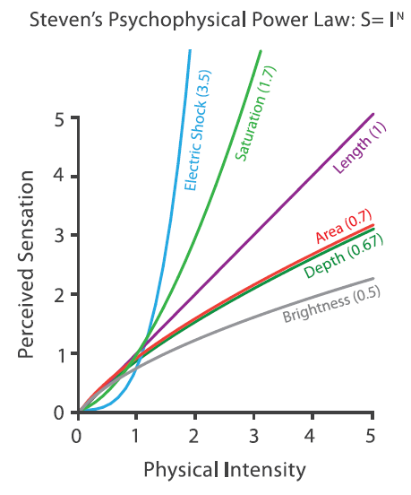
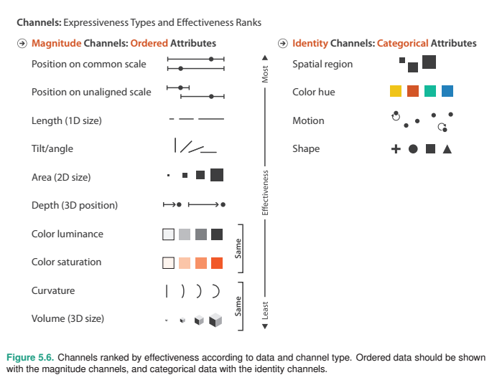
Human perception can quickly compare objects and see that one is greater than, equal to or less than the size of another object, but it is very difficult (or takes a long time) for perception to determine the magnitude of difference to any degree of precision

Slide 10
Steps 5-7 CHECK
Effectiveness of chosen channels
Use of 3D graphs
Clutter
White Space
Message – Message – Message
Can we infer the question by just looking at the graph?

Slide 11
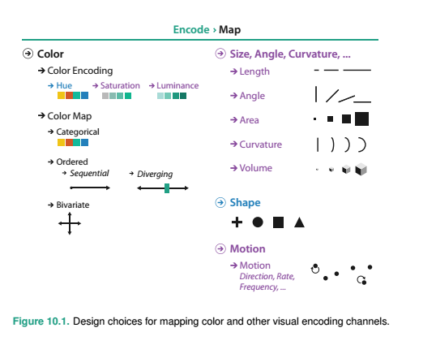
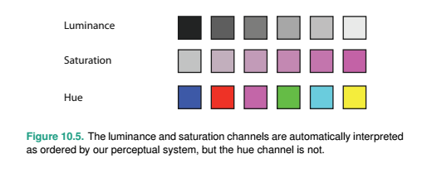
Colour

Slide 13
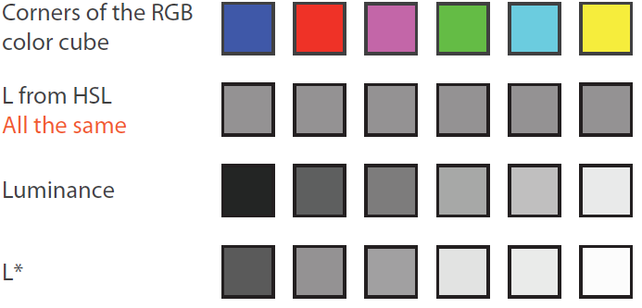
Good colour maps
How do we see?
Red to Green Blue to Yellow Black to White
http://colorbrewer2.org/#

Slide 14
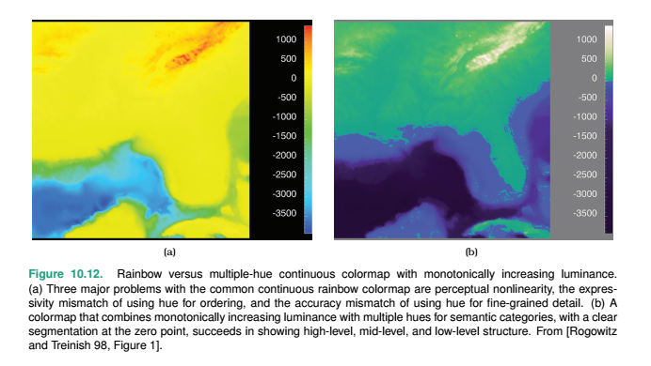

Slide 15
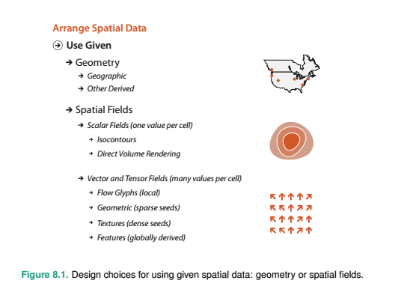
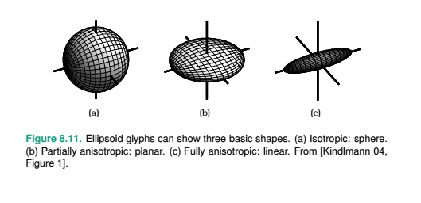
Spatial data
Scalar/vectors/tensor

Slide 16
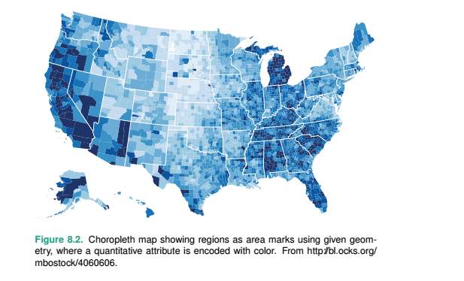
Spatial data
Geometry
Scalar/vectors/tensor

Slide 17
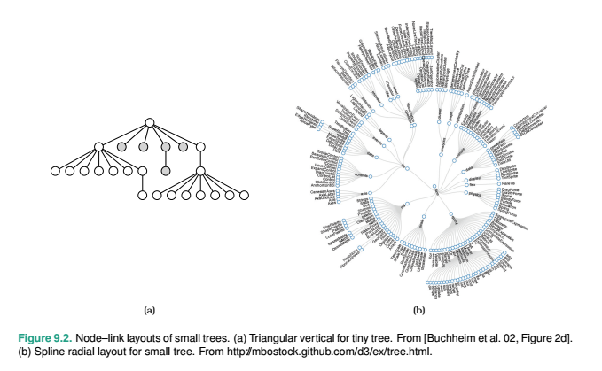
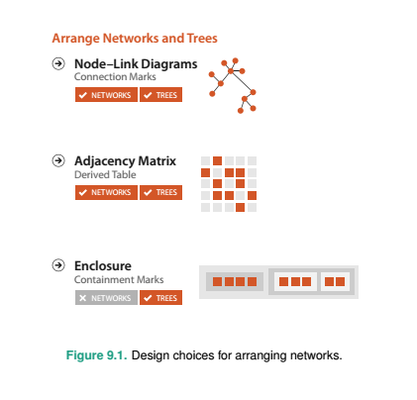
Network data

Slide 18
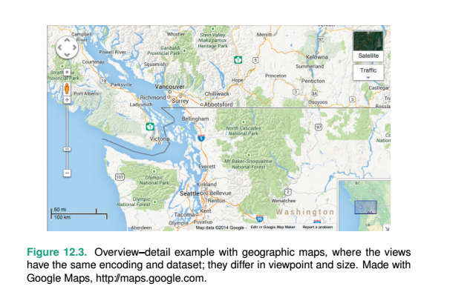
Facet (split)/multiple views
Juxtapose

Slide 19
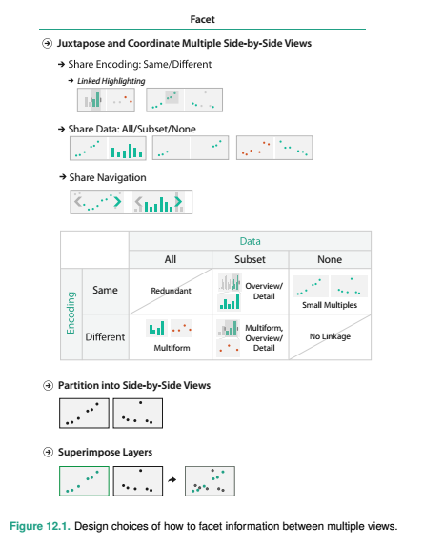

Slide 20
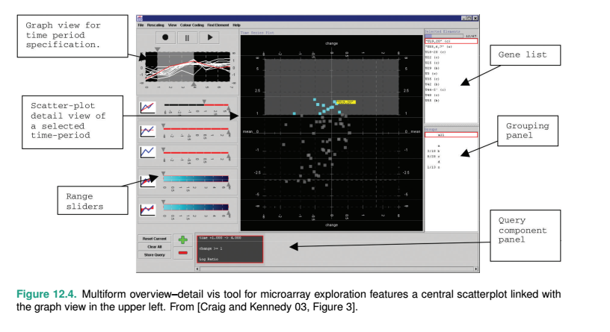

Slide 21
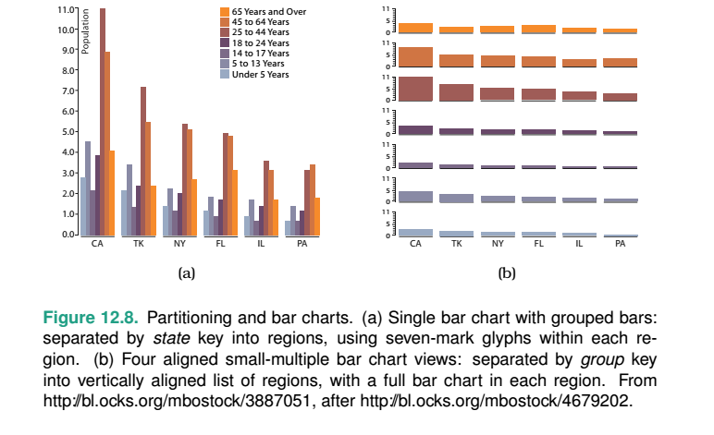
Partitioning

Slide 22
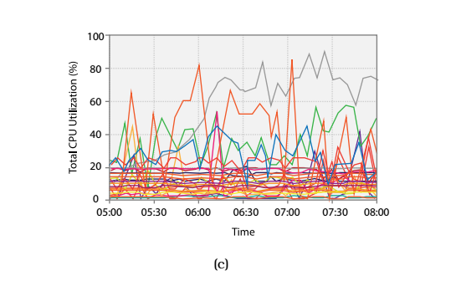
Superimpose

Slide 23
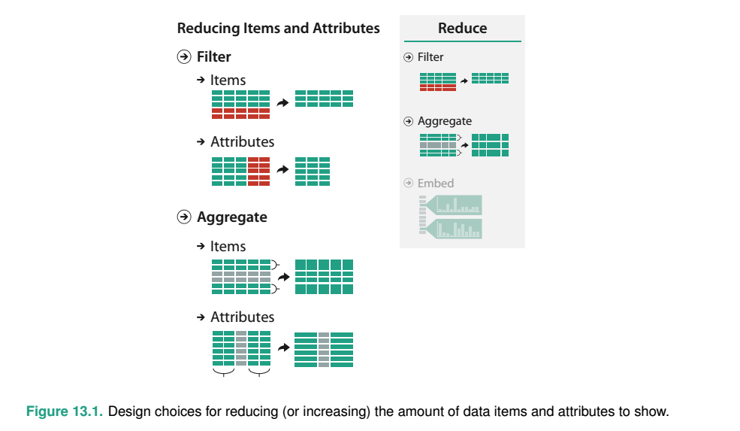
Reduction/simplification

Slide 24
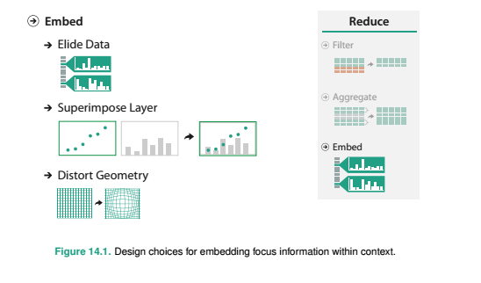
Focus/context

Slide 25
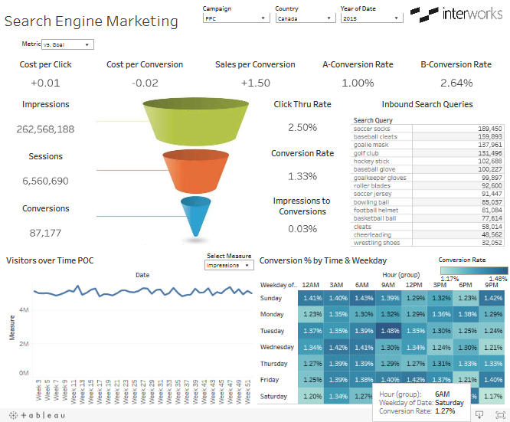
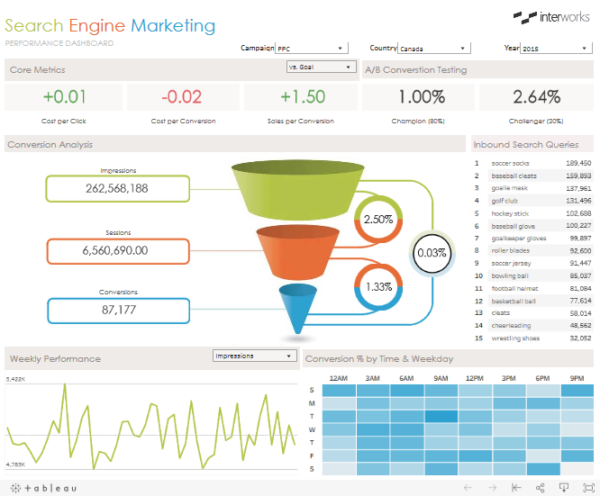
Clean the clutter!

Slide 26
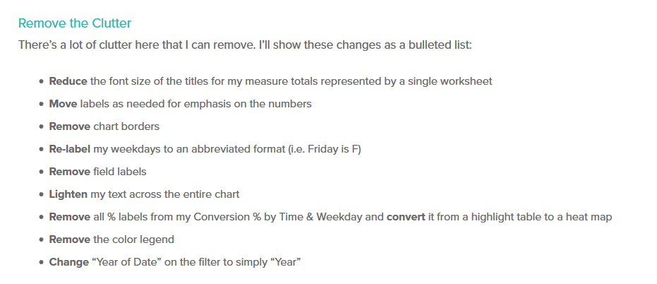
Removing the clutter!

Slide 27
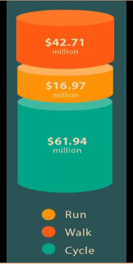
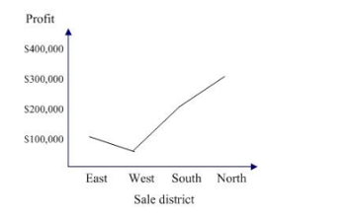
Practices to avoid

Slide 28
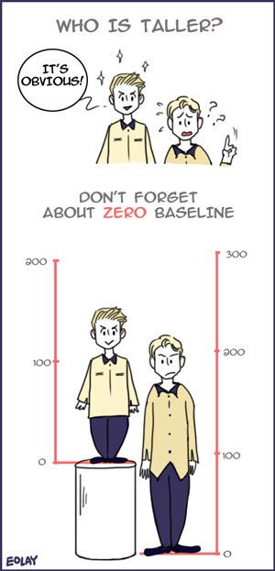
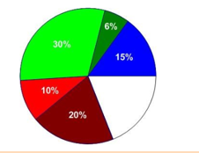
Practices to avoid

Slide 29
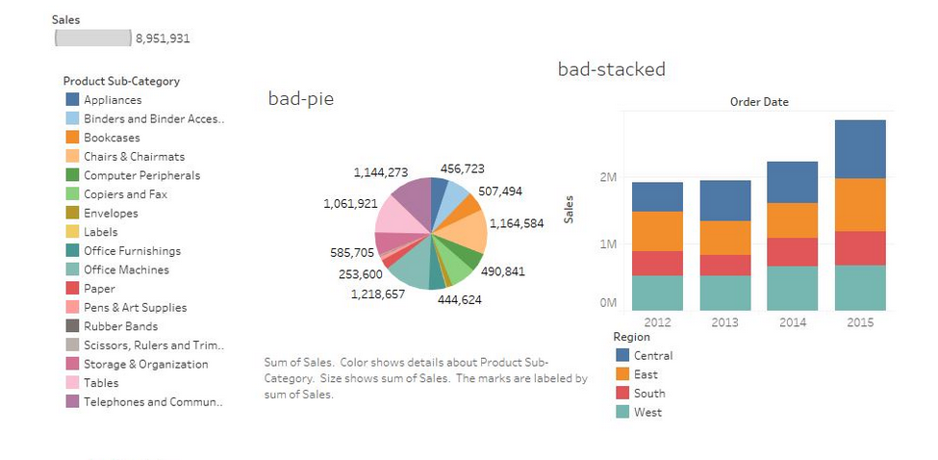
Practices to avoid

Slide 30
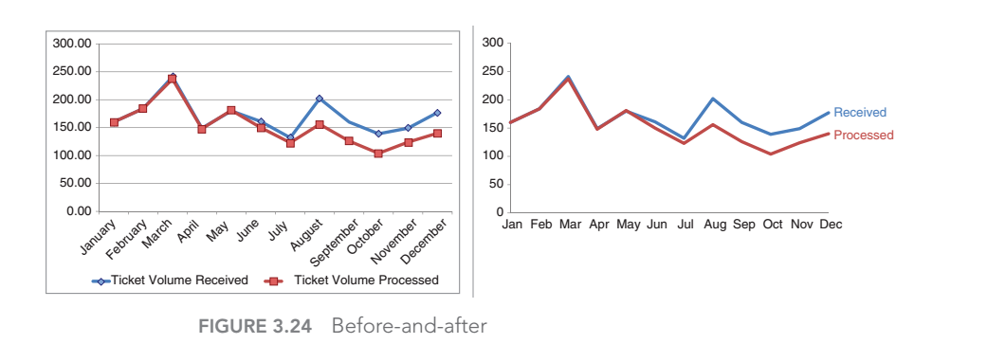

Slide 31
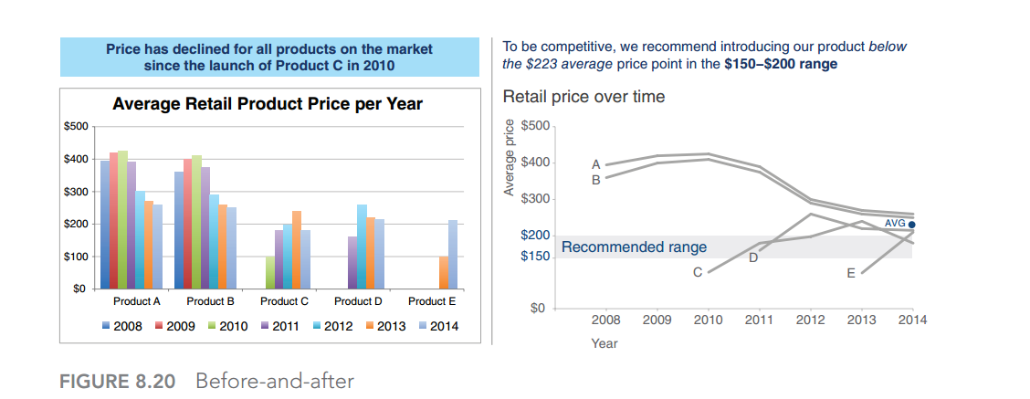

Slide 32
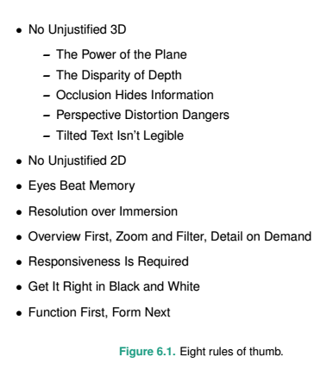
Other resources
Linkedin Learning
https://www.jcu.edu.au/library/learn/linkedinlearning
https://www.jcu.edu.au/learn/news/studiosity
https://www.visualisingdata.com/2017/07/best-visualisation-web-june-2017/
http://www.bigbookofdashboards.com/dashboards.html

Slide 33
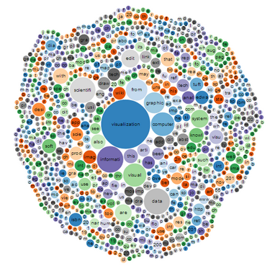
Thanks!!!

